Slide 1
Update
6/15

Slide 2
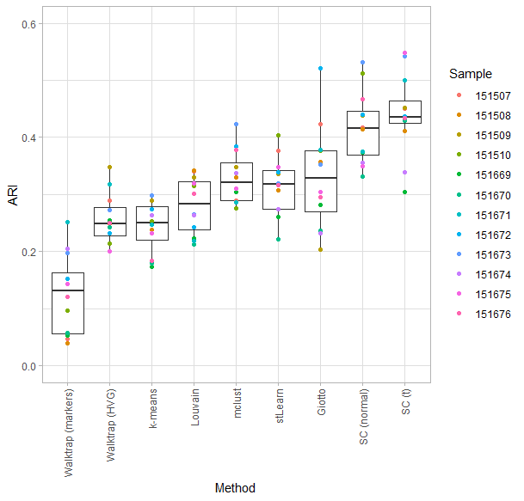
Figure 2D
Giotto with beta = 9 shown
Giotto with beta = 3 performed poorly, including one sample that returned all “NA” for clusters

Slide 3
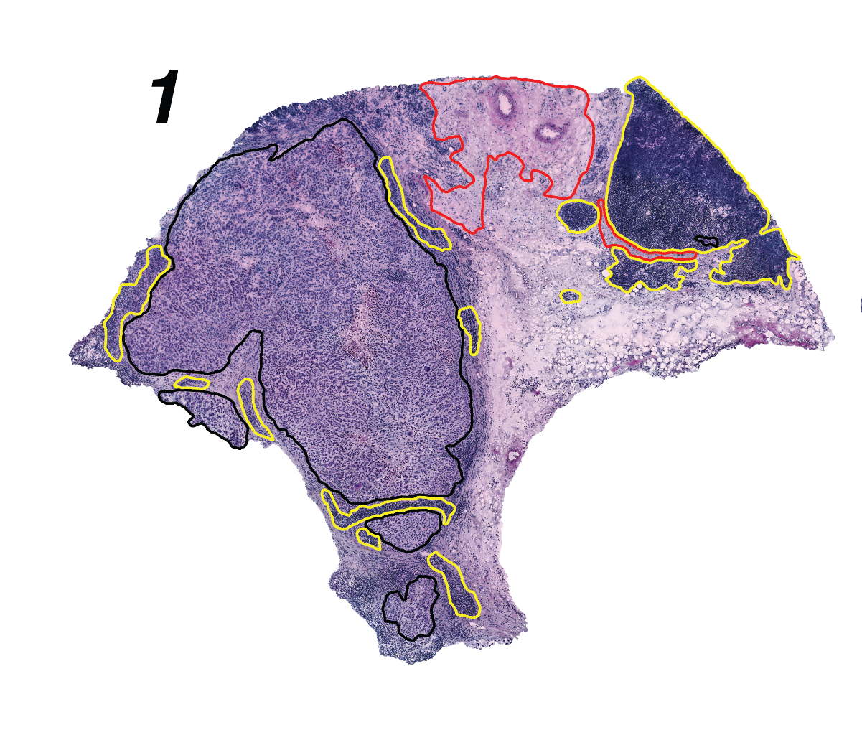
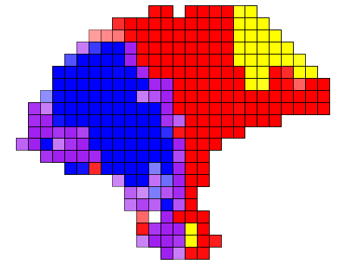
t clustering (Fig 3)

Slide 4
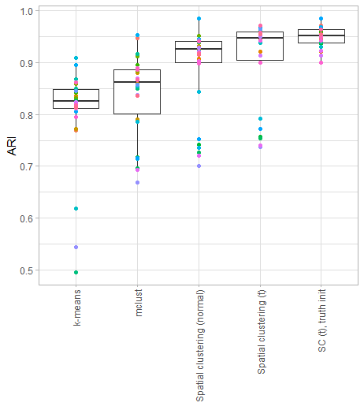
Clustering simulation (Fig 3)
N=30 simulations from t-distribution
Spatial clustering has better performance
Initialization with truth gets rid of the outliers

Slide 5
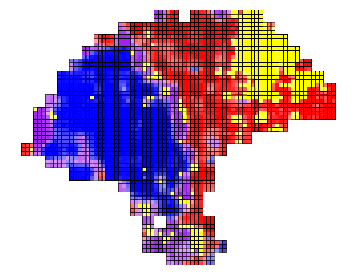
Normal deconvolution

Slide 6

t deconvolution (Fig 4)

Slide 7
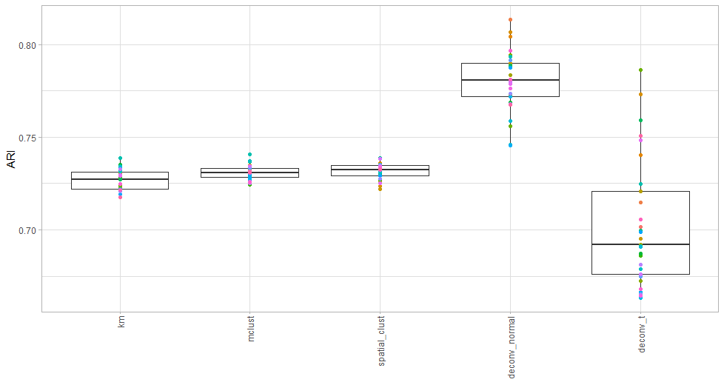

Slide 8
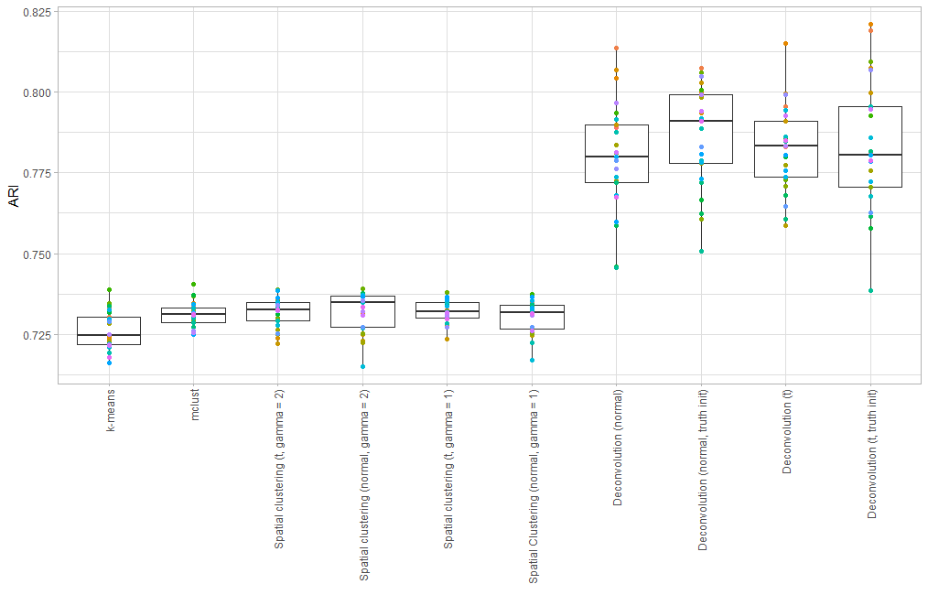

Slide 9
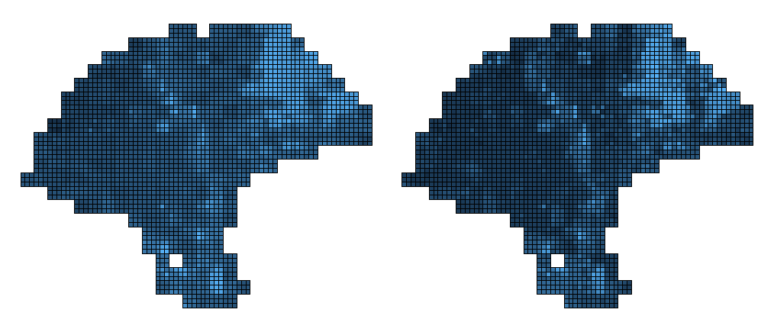
CD19 expression

Slide 10
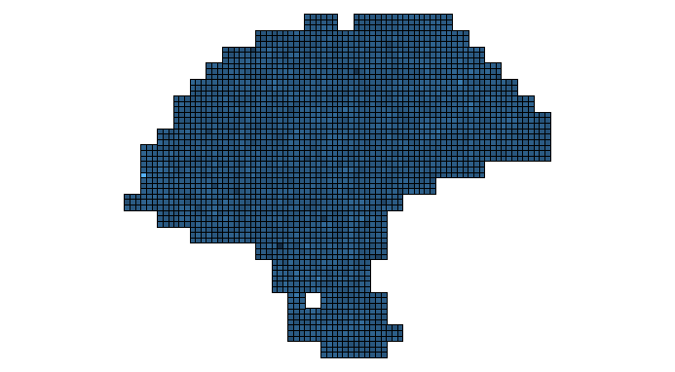
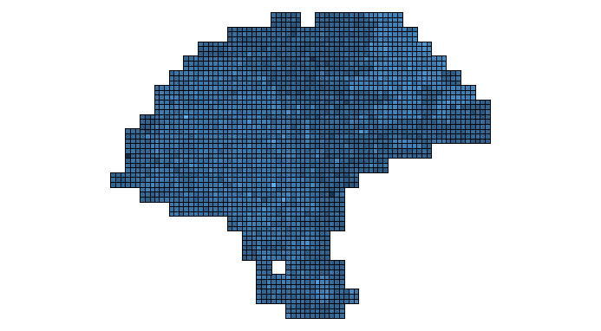
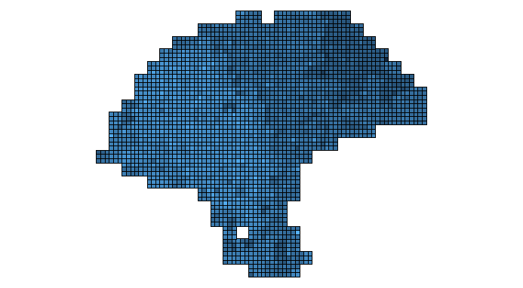

Slide 11
